Slide 1
SCADA IN INDIAN POWER SYSTEM
By Tapobrata Paul
Dy Manager (System Logistics)
NERLDC, POSOCO

Slide 2
POWER SYSTEM COMPONENTS
NERLDC
Generation
Primary Transmission(132/220/400/765KV)
NTPC/NHPC etc.
CB
POWERGRID
Power Plant
X’mer
Bus-bar
Sending end SS
(11/220kV)
CB
Steel Tower
Primary Grid
(220/66 kV)
Bus-bar
Commercial/
FACTORY
66 kV
Industrial
Transmission
Customer
Secondary Transmission(66/132KV)
Urban
Distribution Transformer
Primary Distribution
Customers
(11/0.415 kV)
STU
Secondary Distribution
Secondary Grid
(66/11 kV)
Underground Cable
Distribution
Pole
To Other
Residential
Residential
66Kv
Customer
Customer
Substations

Slide 3
HIERARCHICAL CONTROL CENTRE SETUP
NERLDC
NLDC
5 Nos. RLDC
NRLDC
ERLDC
NERLDC
SRLDC
WRLDC
POWERGRID
Sub Stn.
CS GEN.
Stn.
07 Nos. SLDC
SLDC
SLDC
SLDC
RTU
RTU
RTU
RTU
RTU
Data Collection Units

Slide 4
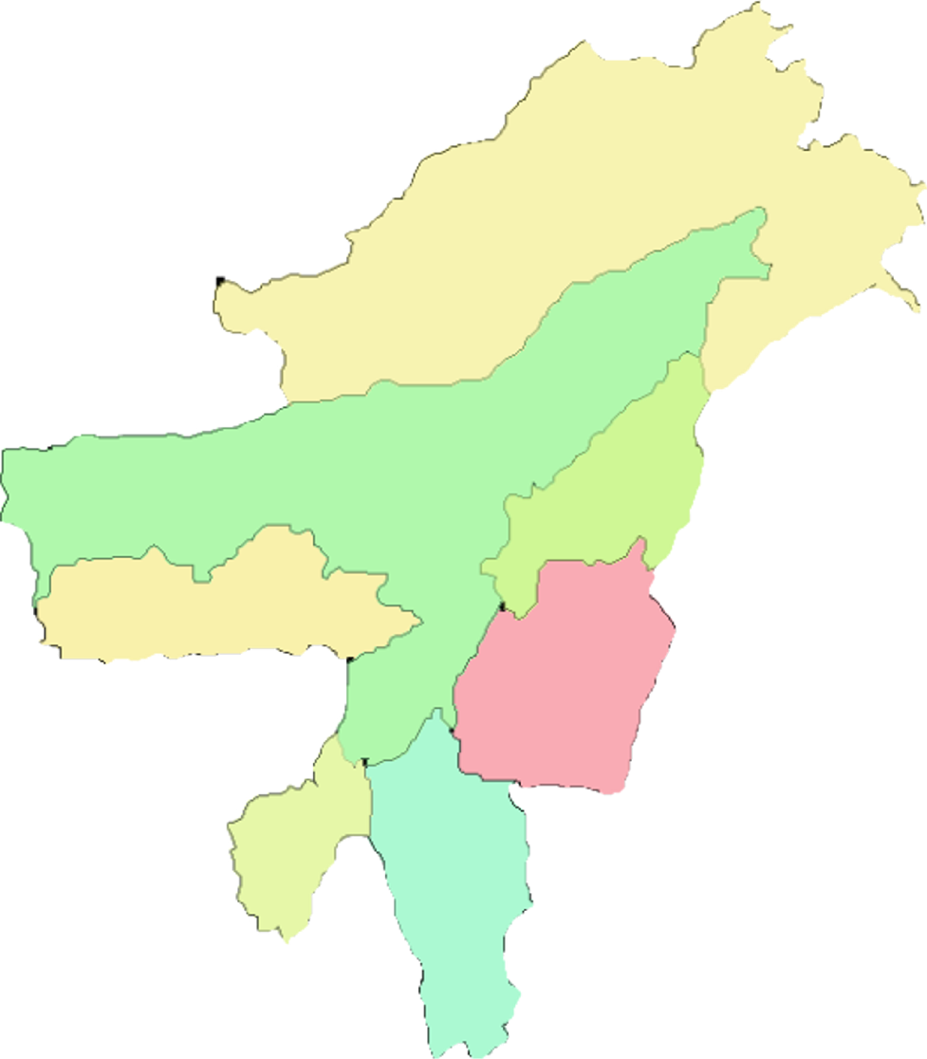
NERLDC
UTILITIES CONTROLLED UNDER NERLDC
SEVEN STATES THROUGH RESPECTIVE SLDCs
Examples:
AS,ME,TE,MI,MA,NA,AR
ARUNACHAL PRADESH
CENTRAL SECTOR GENARATING STATIONs
Examples:
NEEPCO
NHPC
NTPC
ASSAM
NAGALAND
TRANSMISSION UTILITIES
Example:
POWERGRID (Through RTAMC)
MEGHALAYA
MANIPUR
TRIPURA
MIZORAM

Slide 5
WHAT IS SCADA?
NERLDC
SUPERVISORY CONTROL AND DATA ACQUSITION
ASPECTS:
Supervision – Monitoring.
Control – Supervisory.
Data Acquisition System :
a system provided to record the sequence of operation in time, of the relays/equipment as well as the measurement of pre-selected system parameters.

Slide 6
WHY SCADA?
NERLDC
AUTOMATION Requirements
Managing Hazardous/Complex/ Sequential /Repetitive Operations
Centralized management requires feedback
Faster response : quicker and informed decision making
Faster restoration after breakdown
Optimisation of resources, Reduction of losses, and lower operational cost
Increased security, availability, reliability, and efficiency
POWER SYSTEM NEEDS
Before SCADA : Less and delayed information.
Real time disturbance handling problems.

Slide 7
DATA ACQUISITION SYSTEM:
Data flow direction:
NLDC
RLDC
Wide Band
Commn
(FO)
SLDC
SLDC
Wide Band
Commn
Wide Band
Commn
Sub-LDC
Wide Band /
PLCC Commn
Central Sector
RTUs
RTU
RTU
RTU
Substation Level

Slide 8
BLOCK DIAGRAM OF A TYPICAL SCADA SYSTEM
NERLDC
SCADA
H/W &
S/W
C
O
M E
M Q
P
T
C
O
M E
M Q
P
T
Remote
Terminal
Unit
T P
R A
A N
N E
S L
D
U
C
E
R
C & R
PANEL
MEDIA
COMMUNICATION
MEDIA
CONTROL
CENTRE
SUBSTATION / GENERATNG
STATION

Slide 9
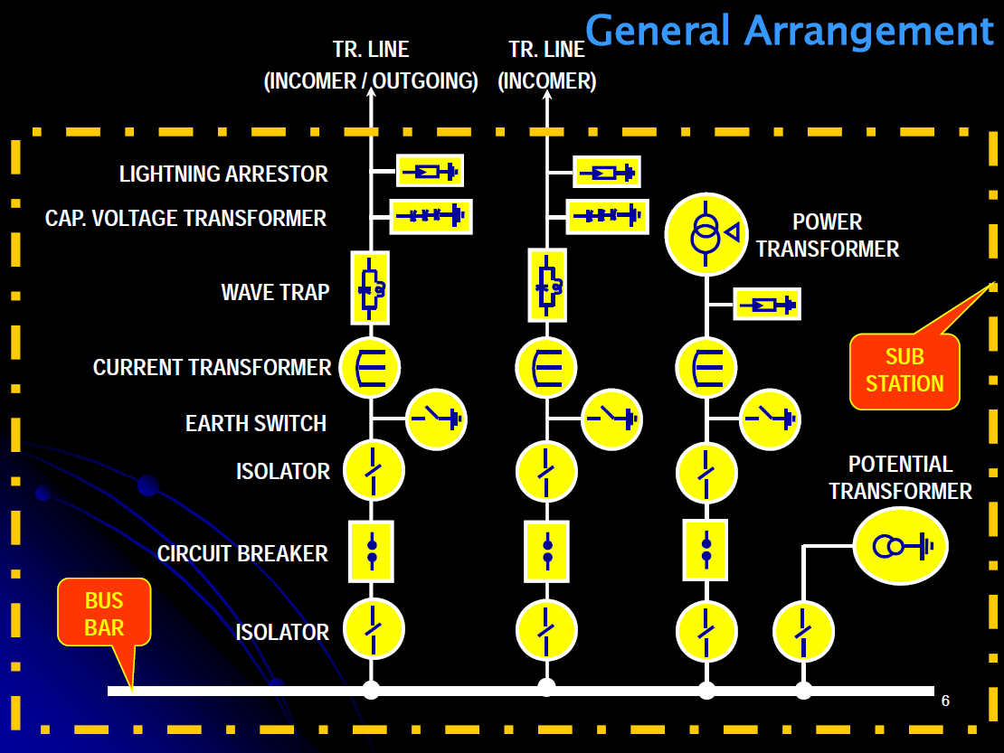
NERLDC
SUBSTATION LEVEL

Slide 10
CURRENT TRANSFORMER
POTENTIAL TRANSFORMER

Slide 11
SCADA HARDWARE CONNECTIVITY WITH COMMUNICATION SYSTEM AT SUB-STN/GEN ST
NERLDC
RTU
PLCC T x / R x
SPEECH / DATA
PANEL
N
S
K
5
RS 232 CONNECTIVITY
TO POWERLINE
PLCC
INDOOR EQUIMENT

Slide 12
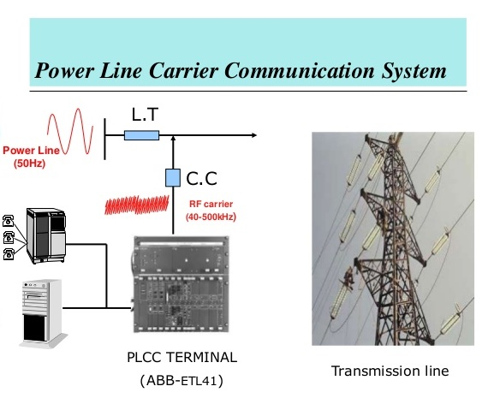
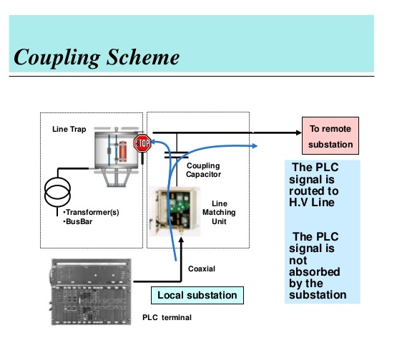
NERLDC
COMMUNICATION SYSTEM (CONT.)
EPBAX
RTU

Slide 13
NERLDC
WAVE TRAP
CAPACITOR VOLTAGE TRANSFORMER

Slide 14
SCADA HARDWARE CONNECTIVITY WITH COMMUNICATION SYSTEM (WIDE BAND)
NERLDC
DIGITAL MICROWAVE
FEP
MUX
RADIO
TX / RX
RADIO
TX / RX
MUX
RTU
FIBER OPTIC SYSTEM
FEP
MUX
OLTE
OLTE
MUX
RTU
OPGW
CONTROL CENTRE
SUBSTATION/ GEN STN SIDE

Slide 15
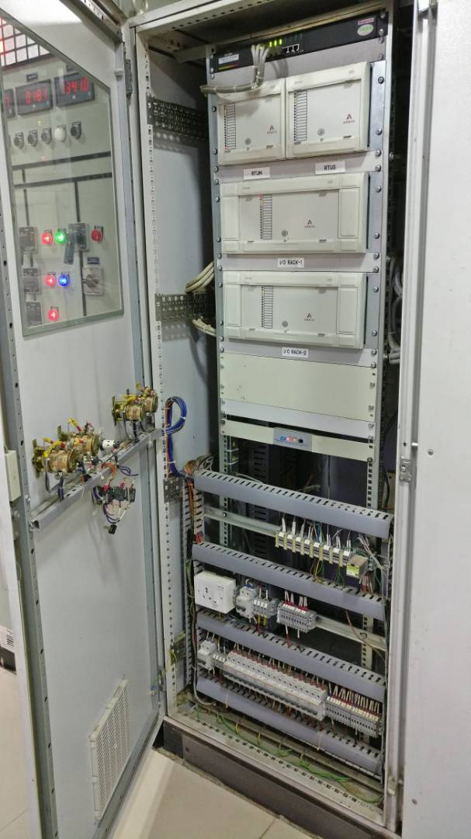
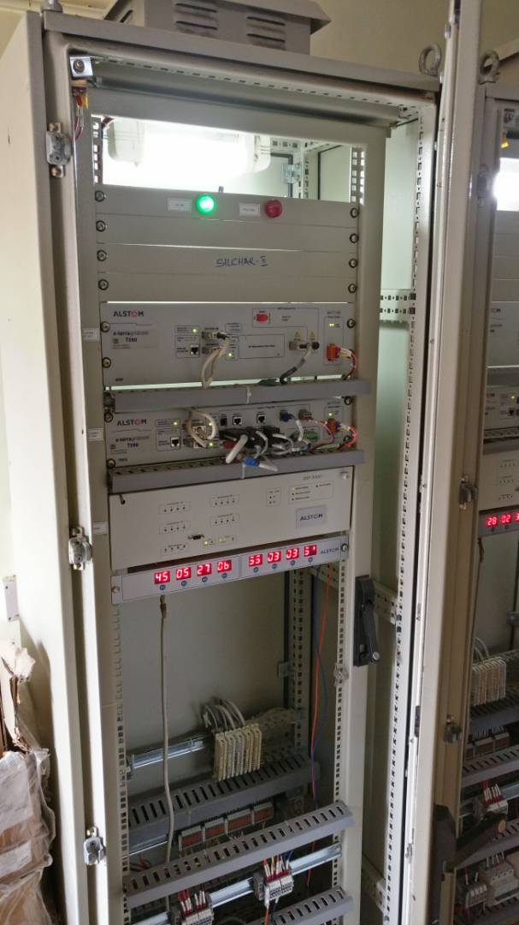
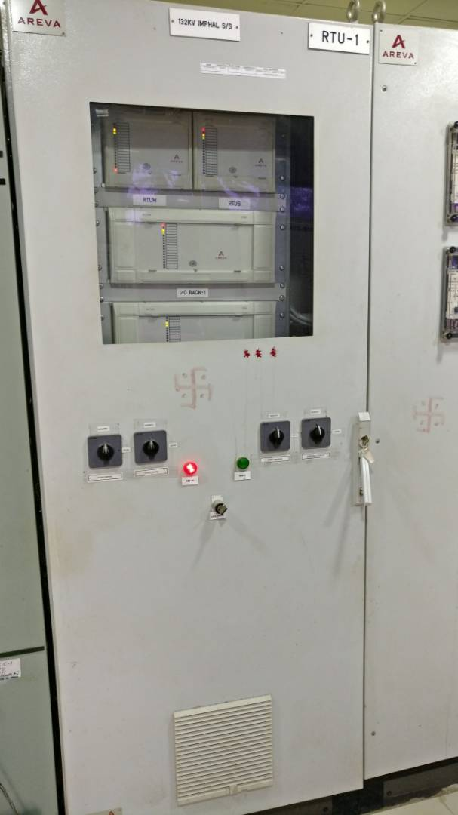
<photos of RTU> <photos of PLCC Panel> <photos of communication panels>
RTU
RTU PANEL
PLCC PANEL

Slide 16
DATA FLOW COMMUNICATION PROTOCOL
NERLDC
RTU
RLDC
FEP
IEC 60870-5-101/104
RTU
SLDC/ Sub LDC
FEP
SLDC ICCP
SERVER
ICCP
RLDC ICCP SERVER
PLCC/BROADBAND
RTU
BROADCASTS IN
SLDC LAN
BROADCASTS IN
RLDC LAN
ICCP
NLDC

Slide 17
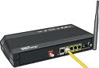
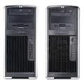
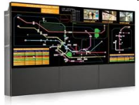


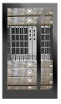


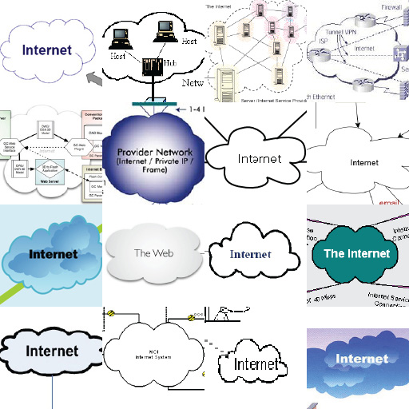
SCADA ARCHITECTURE
RTUs IEC 60870-5-101
RTUs IEC 60870-5-104
VPS MODULE
F/W ROUTER
CFE
DATA ACQUISITION LAN
GPS
WORK STATION
DTS SERVER
SLDC/ OTHER UTILITIES/ OTHER RLDC
WORK STATION
SCADA/EMS
SCADA LAN
DTS LAN
INTERNAL FIREWALL
ICCP
ICCP LAN
OFFLINE LAN
INTERNAL DMZ
PDS LAN
WORK STATION
RD SERVER
PDS SERVER
ISR
NMS
ALL PRINTERS
DATA LAN
EXTERNAL FIREWALL
F/W ROUTER
EXTERNAL DMZ
WEB SERVER/Patch management server
OFFICE NETWORK

Slide 18
SCADA Basic Functions
NERLDC
Data Acquisition:
Process of acquiring data from monitored system.
We use eterrascada.
To acquire data in the monitored system, the e‑terrascada Front End performs the following functions:
* Scans the monitored system at prescribed times and receives data from RTUs via the CFEs.
* Performs conversion and checking on raw data to make it usable for display to operators and other applications.
* Determines the quality of data and marks data that may not be reliable.
* Allows e‑terrascada operators to request scanning of individual scan groups.
e‑terrascada can acquire, process, and display data from three types of devices in the monitored system. These device types are:
* Variable-state devices, which have numerical measurements, referred to in e‑terrascada as “analog points”
* Discrete-state devices, such as circuit breakers and isolators, which have status measurements, referred to as “status points “.

Slide 19
SCADA Basic Functions
NERLDC
Data Processing :
Data quality flags : GOOD, SUSPECT, REPLACED, ESTIMATED, NIS
Alarm checking :
Status :
Illegal and abnormal state
Alarming transitions
Analogs :
Limits checking
Calculation triggering
Topology processing
Power System Analysis
Contigency analysis
Real time network analysis
State Estimation
Sequence of events

Slide 20
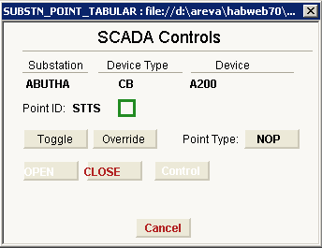
Supervisory Controls
NERLDC
SCADA Basic Functions
Supervisory controls are provided for :
Switching device (open/close)

Slide 21
Supervisory Control Checks
NERLDC
The console issuing the control must have appropriate permission
The controlled point Quality Flag must be GOOD
If suspect, the operator may not see the feed back of the control but the control is authorized.
If the point is already in the commanded state, a warning message appears.
If the control asked is prevented by a tag, the control is rejected.
Interlocks must be satisfied
The associated RTU must be in service
The controlled point must not already be Selected or have a control pending

Slide 22
SCADA EMS
By Tapobrata Paul
Engineer (System Logistics)
NERLDC, POSOCO

Slide 23
Introduction
NERLDC
Power System Overview
Definition of SCADA & EMS
More Details

Slide 24
Topics
NERLDC
❑ Modeling Power System Components
❑ State Estimator, Real Time Network (RTNET)
❑ Contingency Analysis
❑ Load Forecast
❑ Optimal Power Flow, Security Enhancement (SENH),
Voltage VAr Dispatch (VVD)

Slide 25
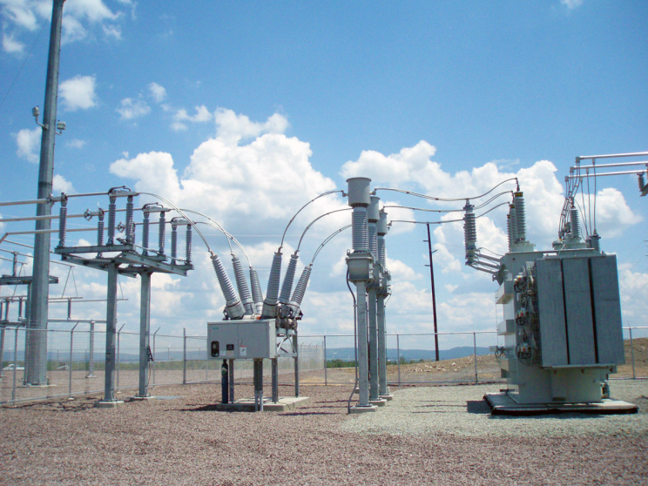
Modelling Power System Components
NERLDC

Slide 26

Modelling Power System Components
NERLDC
Network Model Assumptions
Network Database and Structure
Modeling Connectivity and Substation Structure
Load and Load Area Model
Network Component Model and their Parameters
Network Schedules
Generation Model
Validation

Slide 27
NERLDC
Network Model Assumptions
❑ Basic network model assumptions
3 phase balanced system
implies transposed lines
allows network modeling by a single phase equivalent
branch equivalent PI model
shunt conductance neglected (corona effect negligible)
mutual admittances are neglected (except in SCT)
Resistances defined at nominal temperature
reactances defined at nominal frequency
❑ Special assumptions for unbalanced short circuit calculations
negative sequence impedances equal to positive sequence impedances
no need to model ground return paths explicitly

Slide 28




Sign conventions for Flows
NERLDC
Generators
Stepups
Busbar (node / bus)
Line equivalent PI
Load
( through
stepdowns )
R + j X
( inductive )
Shunt reactance
( capacitive ) ( capacitor )
BCH
BCH
2
2
Shunt reactance
( inductive )
( reactor )
Line compensation
MW sign conventions : Generators : positive to bus
Branches and loads : positive from bus
MVAr sign conventions :
Generators and shunts : positive to bus Branches and loads : positive from bus

Slide 29
NETMOM is the core database for Network Model
NERLDC
Using applications (each with its own copy of NETMOM) :
Network Database
NETMOM
PWRFLOW :
Power FLOW solution
NETMODEL
Topology of power network
. Description of network components
positive sequence
zero sequence
. Equivalent models
. Load and CB forecast schedules
. Regulation schedules
. Load models
. Operating limits
. Application specific data
RTNET :
Real-Time NETwork
Validates
the
network model
CA :
Contingency Analysis
SCT :
Short-CircuiT
SENH :
Security ENHancement
OPF :
Optimal Power Fl

Slide 30
NERLDC
Partial Structure of NETMOM Database
DECK CO
Company Division
DV
ST
Substation Voltage level
KV
(component group)
UN
AUX LD
CP DCCNV
ND
Unit (generator) Station auxiliary load Demand load
Shunt (capacitor or reactor) DC converter
Node
Switching device type
Switching device
Transformer (physical device) Transformer (winding pair)
CBTYP
CB
XFMR
XF
PS
Phase-shifting tap
LINE
Transmission line
Two terminal line segment Zero impedance branch DC line
Load type Load-area
Forecast schedules (by type) Operating area
Equivalent impedances
LN ZBR
DCLN
LDTY LDAREA
SKEDTY AREA EQUIV

Slide 31
Modeling connectivity elements
NERLDC
❑ Nodes and switching devices
Node = set of rigidly connected
links and bus-bars
“yellow” node
“blue” node
“green” node
“red” node

Slide 32
Substation structure
NERLDC
BUS = set of nodes connected by closed switches
“Red” bus
: external node

Slide 33
Bus Load Model
NERLDC
❑ Specifies where, when, and how much power is extracted from the network
❑ Distributes system MW load onto bus loads
Bus load =
“fraction”
baseload + fraction of (system load)
parameters (distribution factors) are updated by an
PL + j QL
adaptive algorithm using “observation points” provided by each run of the state estimator
❑ A more complex hierarchical model of bus loads can be
setup. For example :
System load
Geographical area load (East, West, ...)
Sectoral subdivision
Bus loads
(residential, industrial, commercial, ...)

Slide 34
Example of a load tree
NERLDC
Top level load area ( forecast area )
Load area A WEST
Load area B EAST
Load area B1 RESIDENTIAL |  |  | Load area B2 COMMERCIAL
Load a
Load b
Load c
Load d
Load e
Load f

Slide 35
Load distribution mechanism in a load tree
NERLDC
Top level load area
Base : 1000
Fraction : 0.88
280 + 600 = 880
80 + 150 = 230
200 + 450 = 650
Load area A
Load area B
Base : 80
Fraction : 100
110 + 540 = 650
Base : 200
Fraction : 300
100 + 540 = 640
Load area C
60 + 580 = 640
Base : 100
Fraction : 200
0 + 230 = 230
0 + 145 = 145
60 + 435 = 495
10 + 0 = 10
Load a
Load c
Load d
Load b
Base : 0
Fraction : 50
Base : 0
Fraction : 100
Base : 60
Fraction : 300
Base : 10
Fraction : 0

Slide 36
Example of load tree structure
NERLDC
NOT proportional to total load ;
NOT updated by SE
Top level load area
( forecast area )
Proportional to total load and
tracked by SE
Load-area
Bo (all fixed bases)
Load-area
Load-area R RESIDENTI AL
Load-area C COMMERCIA L
Load- area I1 INDUS
1 shift
Load- area I2 INDUS
2 shifts
Load- area I3 INDUS
3 shifts
Load-area
B
(all time dependentb ses)
B1
(all time
dependentba
ses)
a

Slide 37
Time dependence of loads
NERLDC
❑ Week
subdivision into
WEEK SEGM ENTS
From | SUN | 00:00 | to | MON | 12:00 | Day seg : WE
From | MON | 12:00 | to | FRI | 12:00 | Day seg : WRK
From | FRI | 12:00 | to | FRI | 24:00 | Day seg : FRI
From | SAT | 00:00 | to | SAT | 24:00 | Day seg : WE
❑ Day
subdivision into a set of DAY SEGMENTS
WE day segments :
00:00 - 08:00 - 09:00 - 11:00 - 17:00 - 19:00 - 23:00
❑ A set of day segments is assigned to each week segment
❑ Day segments repeat themselves within the same week segment
❑ Load characteristics are constant within a day segment

Slide 38
Entering data for loads (summary)
NERLDC
Enter data for individual loads :
Load area
Base MW load value
Parent MW fraction
Base MVAr load value
Load MVAr schedule name

Slide 39
Modeling generating units
NERLDC
❑ Insert UN records
❑ Enter unit parameters :
rated MVA
regulation schedule name
base MW
min, max MW
participation factor
ramp rate
corresponding GENMOM unit
PG + j QG
❑ Define unit regulation schedules and enter schedule values
❑ Define MVAr capability curve table

Slide 40
GENERATOR FEASIBLE OPERATING DOMAIN
(MVAr capability "curve")
NERLDC
MVAr limits
❑ Reflects :
Max MVAR Capability
MVA limit due to the stator current
prime mover MW capability
MW
output
Several such curves can be stored
User selects the desired curve

Slide 41
Modeling shunt capacitors
NERLDC
❑ 1. Insert CP records
❑ 2. Enter shunt capacitor nominal MVAr (negative value indicates a “reactor”)
❑ 3. Enter name of node where
voltage is regulated
(must have a CB to regulate)
❑ 4. Enter a regulation schedule
Capacitor
Reactor

Slide 42
Modeling Lines
NERLDC
❑ Insert Line records
Insert line segments records
LN
LNLIM
Insert zero impedance branch
ZBR
ZBRLIM
records
❑ Enter line segment parameters :
❑ Percent value = 100 * perunit value
❑ Perunit value = ohm value / impedance base
❑ Impedance base = square of voltage base / power base
Resistance | R % |  | (on a 100 MVA / nominal voltage base)
Reactance | X % |  | (on a 100 MVA / nominal voltage base)
Line Charging | BCH | % | (on a 100 MVA / nominal voltage base)
❑ Enter line length

Slide 43
Line parameters
NERLDC
PI model for a line segment
“FROM” Bus k
“TO” Bus m
R_{km} + j X_{k}
m
0.5 BCH_{k}
0.5 BCH_{k}
m
m
Resistance | R % |  | (on a 100 MVA / nominal voltage base)
Reactance | X % |  | (on a 100 MVA / nominal voltage base)
Line Charging | BCH | % | (on a 100 MVA / nominal voltage base)

Slide 44
Modeling transformers
NERLDC
❑ Insert XFMR, XF records
❑ Define transformer tap types :
“FROM”
LTC side “I” side
tap type name
min, max, nominal tap position
per unit step size
time delay before tap can move
“TO”
FIXED side “Z” side
❑ Define transformer regulation schedules
❑ Enter transformer parameters :
nameplate information
tap type for each side
normal tap position for each side
voltage sensitivity
master / follower and current balancing flag
PI model and saturation coefficients (see next slide)

Slide 45
Transformer model : impedances
NERLDC
❑ Transformer model :
I₁
R + j X
Gmag
(iron
loss)
Bmag
(magnet. suscept.)
kU₂
U₁
R and X parameters can be determined by short-circuit test
Gmag and Bmag
parameters can be determined by open-circuit test

Slide 46
Defining Transformer Tap Types
NERLDC
❑ For a voltage transformer, the tap model refers
to voltage magnitude
❑ Tap type :
max tap
Example :
Step size = + 0.005
MaxTap = +16 ===> V1/V2
= 1.08
nominal tap (causes no change in voltage)
Nominal = 0
= 1.00
===> V1/V2
per unit step size
min tap
Per unit step size for a transformer =
per unit increase in voltage transformation k = ( V1 / V2 )
that occurs with each increase of the tap position.
MinTap = -16
V1/V2 = 0.92
===>
Step size is positive if k (MaxTap) > k (MinTap), negative otherwise

Slide 47
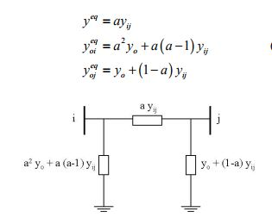
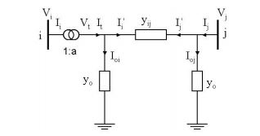
Effect of tap position in Modelling
NERLDC

Slide 48

GE NERATION data base :
NERLDC
GENMOM
❑ Hierarchy defines the existence of generation
system components :
Operating areas ( OPA )
GENDECK
OPA
Plant controllers ( PLC )
Generating units ( UNIT )
Utilities ( UTIL )
Tie corridors ( TIE )
Tie lines ( TYLN )
Transacting areas ( TRA )
PL
PLC
UNIT
UTIL
TIE
❑ Fuel types
TYLN
❑ Generation types
TRA
❑ Allowable transaction types and actual transaction data are stored in a separate database (TSKED)
FUELTY
GTYPE

Slide 49
GENERATION CONTROL
NERLDC
❑ Basic concepts
Operating area (OPA)
(also called "control area")
Generators
Portion of the electric power system in which generation is centrally controlled to ensure continuous matching between supply and demand
Loads
Isolated operating area
Frequency variation speed is a measure of the current imbalance between generation and load
Frequency is an integrated measure of the generation and load imbalance
Gen
Interconnected operating areas
Gen
Interchange flows have to be controlled to the scheduled value by each OPA
Load
Load
Gen
Load

Slide 50
Generation control organization
NERLDC
Operating constraints
Cost elements
Control center ( EMS)
Power station
Current status / generations / frequency
PLC
*
Unit
AGC (RTGEN)
Controls
( Base-points schedules )
Local frequency regulation (speed governor)
Interchange transactions
Control centers
of other control areas

Slide 51
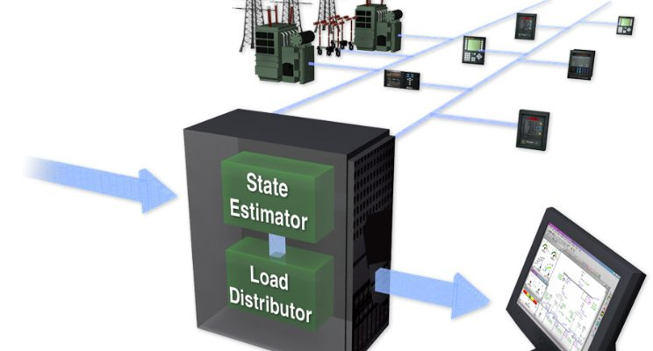
State Estimator: Real Time Network (RTNET)
NERLDC

Slide 52

Network Validation
NERLDC
Information (Information to the user not Harm-ful)
Warnings (to so that the model can be improved)
Hanging Nodes etc.
All Warnings need not be harmful.
Errors (Harmful)
All errors should be removed before the model can be set
online.

Slide 53
Real Time Network (RTNET)
NERLDC
Topics
❑ RTNET functions
❑ State estimator variables and equations
❑ Weighted least squares (WLS)
❑ Measurement weights - accuracy classes
❑ Observability
❑ Pseudo-measurements
❑ Estimation procedures

Slide 54
RTNET (CONT.)
NERLDC
functions
❑ Determine the network state given :
the network model (equations and parameters)
the network topology (derived from status measurements)
available analog measurements
models of load and generation bus injections
❑ Inform about possible violations of operating constraints
❑ Identify anomalous measurements
❑ Calculate measurement error statistics
❑ Identify modeling errors
❑ Improve modeled information
❑ Calculate loss sensitivities

Slide 55
State Estimator variables
NERLDC
❑ State vector X
State variables [X] consist of a subset of the variables characterizing the electrical state of the power system. They are explicitly solved by the state estimation algorithm. Basically, X = complex voltage vector.
The remainder of the power system variables are deterministically
dependent on the state variables:
Y =h(X)
Basically, Y = complex power flows.
❑ Measurement vector Y
Bus voltage magnitudes
MW and MVAr flows in lines, transformers, and bus injections
Transformer tap positions
❑ Other variables or parameters in R T N E T not related to the current
electrical state of the system :
Measurement bias and standard deviation

Slide 56
State Estimator Equations :
NERLDC
❑ Bus balance equations (First Kirchhoff law):
Require the sums of real power flows and reactive power flows into a bus to be zero.
Zero injection bus equations are associated with relatively high levels of confidence (low uncertainty).
❑ Measurement equations relate a measurement to :
either directly a solution variable (voltage magnitude)
or an implicit value calculated from solution variables (power flows)

Slide 57


Least Squares State Estimation
NERLDC
lThe
measurement equations are :
Y = h(X) + V
X = column-vector of state variables
Y = column-vector of measurements
V = column-vector of measurement errors (zero mean, uncorrelated, Gaussian)
where
l This is an over-determined powerflow problem
using the information from M independent measurements
Y = { y_{j} }
to solve for N unknowns (state X or solution variables), where
M is greater than N ( M-N = degree of freedom )

Slide 58
Weighted Least Squares (WLS )
NERLDC
❑ The best estimate of the state variables X is obtained by the Weighted Least Squares (WLS) method. The objective is to minimize the sum of the squares of the weighted deviations of the estimated measurements from the actual measurements:
Min J(X) = Sum_{j} { [ y_{j} - h_{j}(X) ] / σ_{j} }²
σ reflects the measurement uncertainty
The value of J is called the “cost” of the solution.
❑ In matrix notation,
J(X) = [y-h(X)]^{T} W⁻¹ [y-h(X)]
W is the covariance matrix of measurement errors, which reflects the measurement confidence. In the case of independent measurement errors, W⁻¹ is diagonal with
w_{jj} = 1/σ ²
j

Slide 59

WLS iteration types
NERLDC
^{X}k+1 ^{- X}k
= [ H^{T} W⁻¹ H ]⁻¹ H^{T} W⁻¹ [ Y-h(X_{k}) ]
❑ FACTOR :
Full rebuild of all matrices and factorization of the normal matrix with optimal reordering ( in case of topology change or change in the set of available measurements )
❑ REFACTOR :
Same without revising the factorization order
❑ REPEAT :
Recalculate only the RHS and use the same normal matrix inverse to update X
❑ RHS :
Repeat with updated W for de/re-weightings

Slide 60
RTNET
State Estimator solution convergence cycles
NERLDC
Get measurements from SCADA Filter gross errors
Solve linearized WLS problem
Implement weight changes
Voltage converged
?
Solution valid
?
Update measurement error statistics

Slide 61

Estimating injection components
NERLDC
G_{meas}=100 ; sigma²=0.3
Est =38
❑ Branch flow estimates yield net injection estimate
Est =53
NI_{est} = 38 + 53 = 91
❑ Measured net injection = 100 – 12 = 88
D =12 ; sigma²=1
meas
❑ Measurement error = 91 – 88 = +3 ➔ injection component estimates must be further apart than measured values
❑ Allocate correction to injection component in proportion of their variances :
G_{est} = G_{meas} + 3 * (0.3 / 0.3 + 1) = 100 + 0.69 = 100.69
D_{est} = D_{meas} - 3 * (1 / 0.3 + 1) = 12 – 2.31 = 9.69
❑ In this process, pseudo-measurements and their variances are used in case of
lacking measurement(s)

Slide 62





RTNET
NERLDC
Observability
S
MW MVAr
MW
MVAr
δ
kV
δ
MW MVAr
δ
TAP
MW MVAr
MW MVAr
δ
δ
S
❑ Measurement-Observable (or strictly speaking : “observable”) Portions of the network where RTNET can estimate the state using only actual measurements.
❑ Observable (or strictly speaking : “solvable”)
Portions of the network where RTNET can calculate the state using available measurements, complemented by pseudo-measurements (based on modeled information).
= set of “non-measurement observable” buses

Slide 63
RTNET : unified solution for observable and unobservable
NERLDC
❑ Pseudo-measurements are used to complement actual measurements in order to allow full network solution
❑ Pseudo-measurements are generated from :
MW generation from economic dispatch / commitment
MVAr generation from voltage regulation schedules
MW / MVAr load models and schedules (updated from past records)
❑ Above information translates into a single type of pseudo- measurement: unit and load injections
❑ Measurement vector Y is extended to include minimal number of pseudo-measurements
❑ Pseudo-measurements are given greater uncertainty than actual measurements

Slide 64
RTNET: Summary
NERLDC
Measured values of :
Topology (switch pos.)
Voltages Injections (G-L) Branch flows
❑ Measurements you define have more influence on the result than other measurements
❑ Uses the WLS approach to find a network state that is most consistent with:
all the measured data
the modeled data (pseudo-measurements)
❑ Estimates tap positions
❑ Unified solution for measured and non-measured portions of the network
Tap pos.
STATE ESTIMATOR
Solve the normal WLS equations (derived from the m measurement eq. ) for the actual network
under current conditions
Estimate of :
voltage angles Θ
voltage magnitudes V
Branch flow equations
Estimate of :
Branch flows
Injections

Slide 65




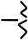
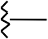


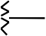

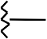


RTNET: Inputs and Outputs
NERLDC
SCADA
RTGEN
Unit MW base-points and MW limits
Unit participation factors
Unit ramp rates
Unit control status and on/off-line status
Scheduled area transactions
•
Network component MW and MVAr flow measurements
Bus voltage mag. & angle meas.
Transformer and phase shifter tap positions
Data quality information
NETMODEL
NETMOM
G
G
RTNET
NETMOM
G G
Output :
Bus voltages and angles
MW / MVAr flows
Limit violations
Generations and loads
LTC tap positions
Anomalous input data
Loss sensitivities

Slide 66
RTNET’s checks on input data
NERLDC
❑ SCADA performs a quality check before passing data to RTNET
❑ RTNET uses SCADA’s quality evaluation to determine whether or not to use the data
❑ RTNET performs elementary coherency checks to ignore measurements in gross error :
voltage on de-energized nodes
flows across open switches
Flows exceeding a multiple of the branch limit
MW or MVAr generator flows exceeding the MVA rating of the unit
MW or MVAr loads exceeding the load limits
Measurements outside reasonability limits

Slide 67
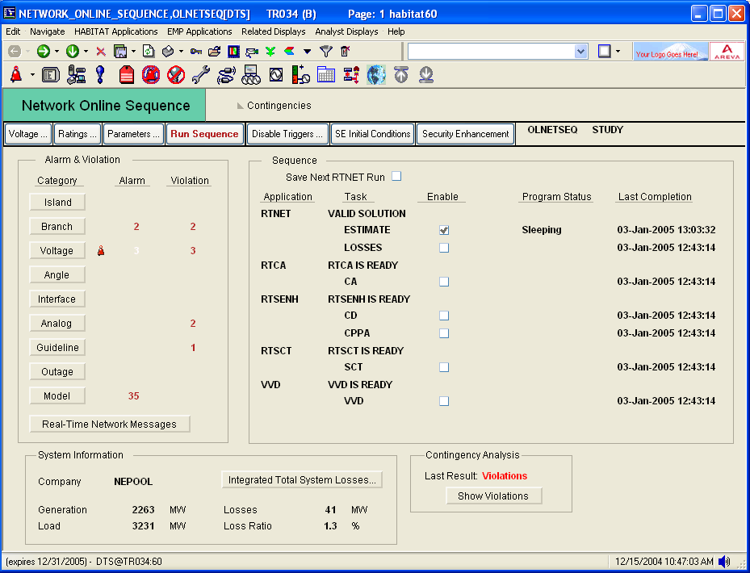
RTNET : Results
NERLDC
Monitoring
RTNET

Slide 68
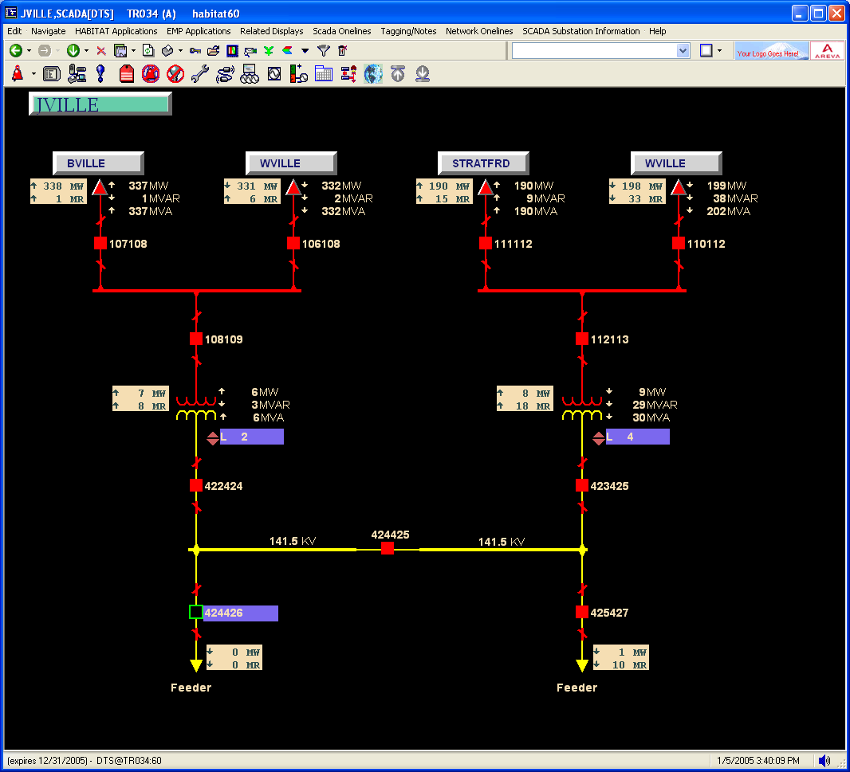
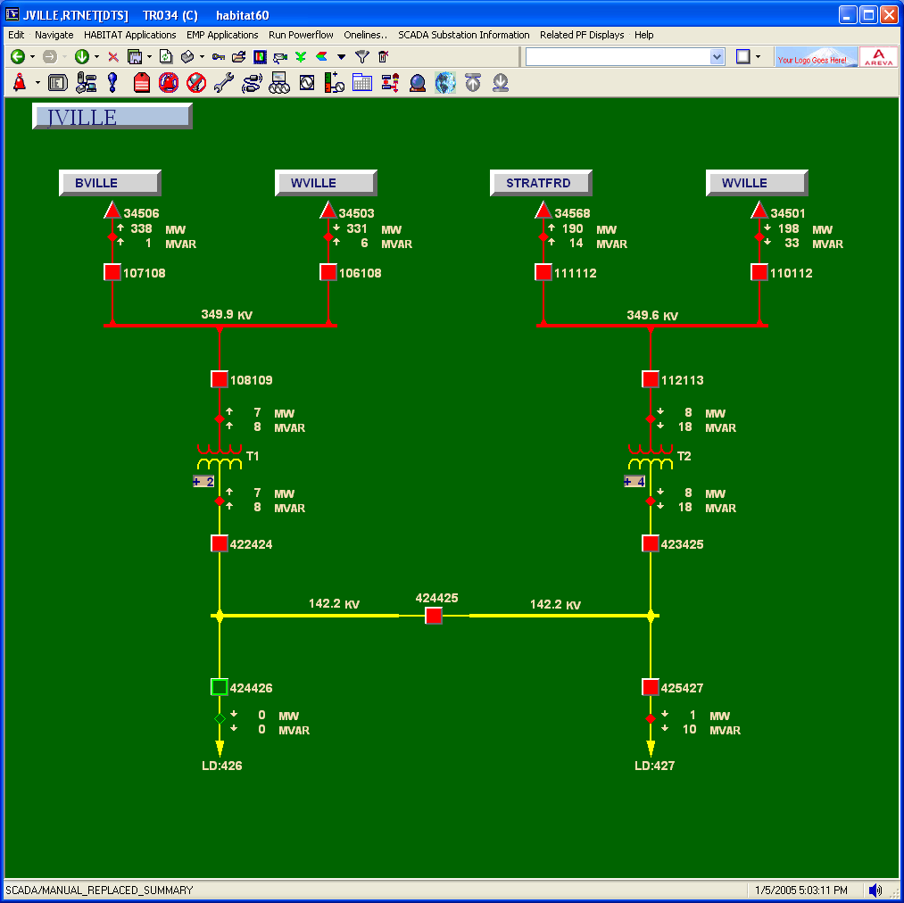
NERLDC
the network state
RTNET : Results
SCADA substation diagram
Network substation diagram

Slide 69
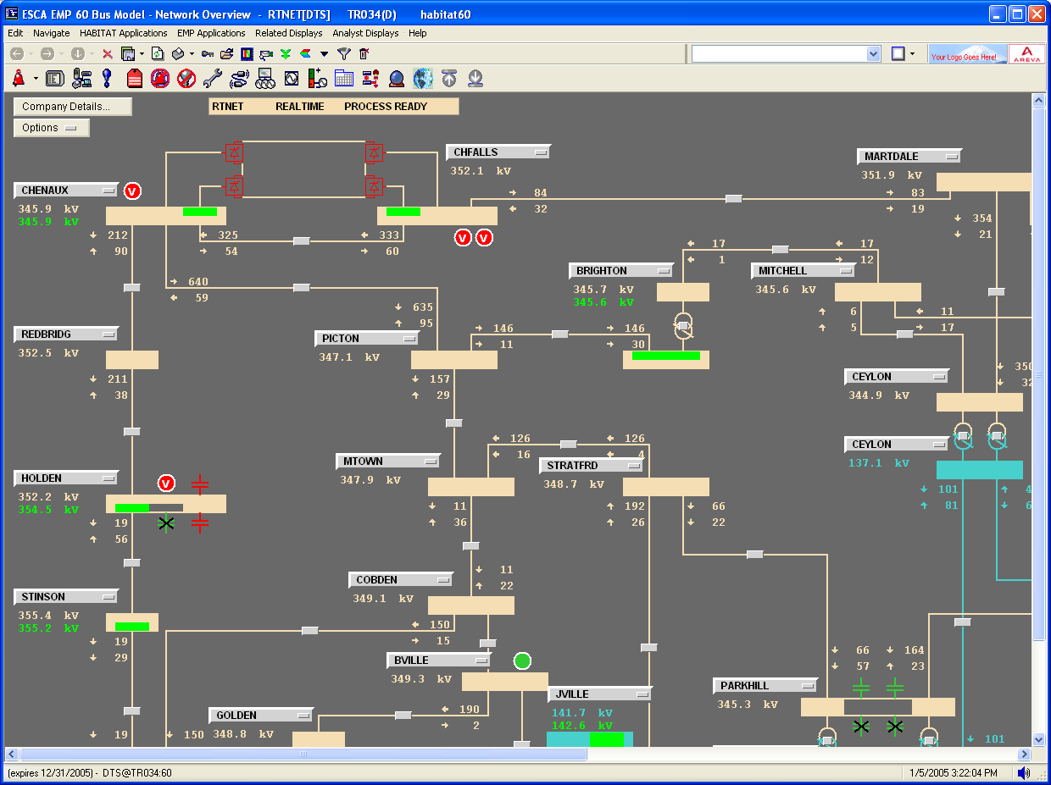
NERLDC
Network oneline diagram

Slide 70
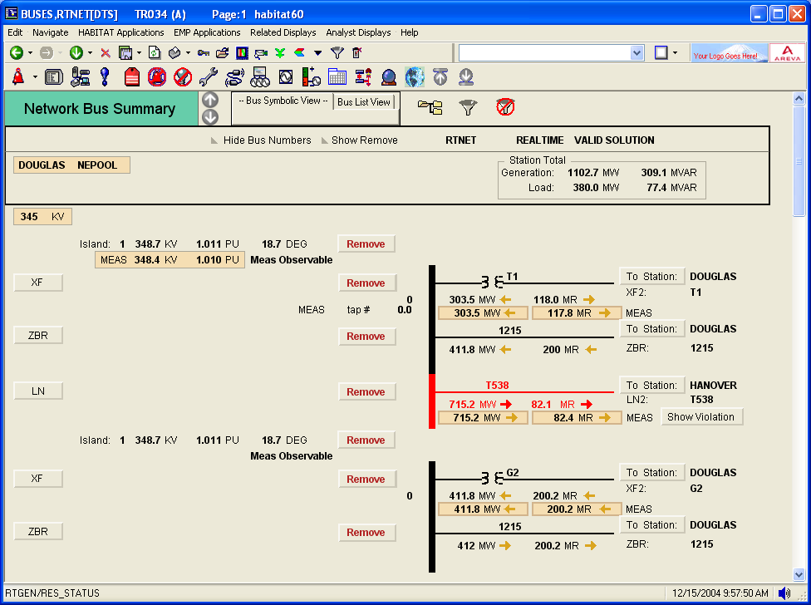
NERLDC
Bus Symbolic View of the Bus Summary display

Slide 71
State estimation: ASSUMPTIONS
NERLDC
Basic network model assumptions
3-phase balanced system
mutual admittances are negligible (except in SCT)
branch equivalent PI model
shunt conductances neglected (corona effect negligible )
impedances defined at nominal frequency
Specific assumptions for the state estimator : correct impedances
correct topology
correct line parameters R, X, BCH
correct transformer models:
Losses (iron, copper)
Magnetization susceptance
Tap: position, model (sign, step, impedance effect)
❑ Special assumptions for measurements:
correct measurement location (point-to-point tests)
no bias
correct weight ( = correct measurement error variance)

Slide 72
RTNET : Error detection
NERLDC
❑ Error detection
Based on CHI-square test:
the solution cost “J” follows a CHI-square distribution with M-N degrees of freedom
( M-N = number of measurements – number of state variables).
J will be larger than expected in the presence of bad measurement data
❑ Error identification
Based on equation residuals evaluated at the calculated network state:
Residual = estimated value - measured value
Large residuals generally indicate that the associated measurement (or bus equation) is grossly in error or anomalous

Slide 73
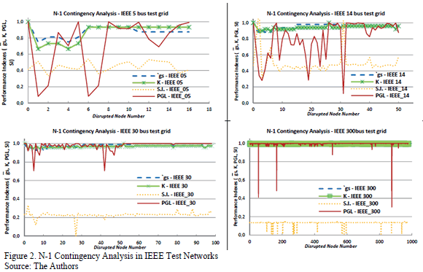
Contingency Analysis
NERLDC

Slide 74

Contingency Analysis : Overview
NERLDC
What if this generator
is outaged ?
kV
What if this transformer is outaged ?
❑ Contingency Analysis reports which hypothetical contingencies would cause operating limit violations
❑ Flexible contingency definition
❑ Contingency groups

Slide 75
Contingency Analysis
NERLDC
Contingency analysis covers a variety of analytical investigations performed by both system planners and operators.
The system planner’s objective is to identify the network elements that will be required to maintain system operation within planning criteria.
The general requirement is to identify capital investments and operating costs for long term future developments.
The system operator’s objective is to identify the manner in which the system must be operated to maintain system security both in the near term (days, weeks, months) with existing network elements or the medium term (one to three years) during which a limited amount of equipment could be installed.

Slide 76
Reliability Testing Criteria for Contingency Analysis (Steady State)
NERLDC
Single contingencies (N-1). Loss of any transmission line or transformer or generator. These are often termed probable or credible contingencies.
Double contingencies (N-2). Simultaneous loss of two single-circuit transmission lines, a double-circuit line or dc bipole. Variations on these contingencies exist worldwide specifically with respect to the definition of double circuit and the option of non-simultaneity of loss (N-1-1). These too are credible or probable contingencies.
Less probable contingences and/or extreme contingencies can include loss of entire substations or multiple generators.
Conditional Contingencies

Slide 77
RTCA : Features
NERLDC
Flexible contingency definition :
defined by selecting components in a software prepared list
any combination of component outages and breaker
switching is allowed
any bus structure allowed
Very fast solution :
Contingency screening
Well-developed power flow algorithms for :
ultra-fast approximate solution ( for contingency screening
)
full accurate power flow solution for definite assessment
Accurate modeling of the power system behavior:
Conditional contingencies for simple relay modeling
Automatic controller response modeling

Slide 78










RTCA processing : Screening, selection and full solution
NERLDC
C
INITIALIZATION
Solve basecase network
C
C
C
C
C
_{C} C
C
C
C
C
C
C
Active contingencies
C
_{C} C
C
C
C C
SCREENING
Calculate fast approximate solution for each contingency
( local or widespread )
C
C
Potentially harmful contingencies
( contingencies that have screening violations)
C
C
C
C C C
SELECTION
Rank potentially harmful contingencies
1
2
3
4
5
Select highest ranked contingencies screening violation severity
C C
C C
C
based on
Retained contingencies
1
2
3
C
C
C
FULL solution
Solve selected contingent networks

Slide 79
Contingency: Types
NERLDC
Primary contingency (standard)
Conditional:
specify a component (node or branch)
Specify the condition:
Node voltage > or < some threshold
Branch flow > some threshold
If condition is true in the result of primary contingency, implement a secondary contingency
Report violation only if some exists in the result of the
secondary contingency
Report if condition was true

Slide 80







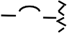


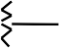
RTCA: Input and Output
NERLDC
Input:
NETMOM
Contingency definitions
CTGS
Contingency definitions
Output:
Basecase violations
PWRFLOW or RTNET
G G
STCA or RTCA
G
G
Effect of contingencies:
monitored element violations
loss of load
loss of generation
islanding
BASECASE

Slide 81
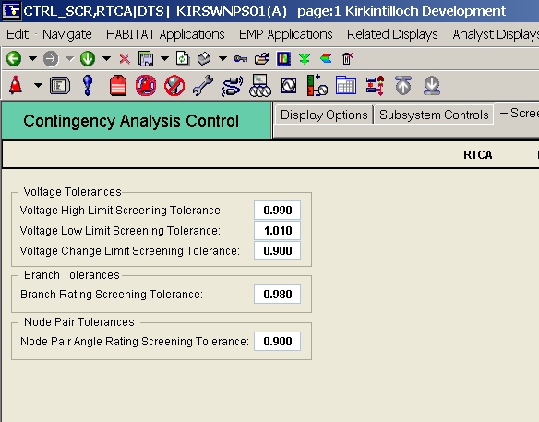
CA : Specifying contingency screening parameters
NERLDC
❑ Violation
tolerances
❑ by type of monitored element

Slide 82
RTCA : Ranking parameters
NERLDC
Contingencies are ranked in screening phase based on
The magnitude of violations they cause
The level of limit being violated ( 1 2 3 )
A ranking number is calculated for each type of
violation :
RANK = (level violated) * WT1 + (percent violation) * WT2
WT1 :
WT2 :
ranking
Weighting of violated level in contingency ranking
Weighting of violated percentage in contingency

Slide 83
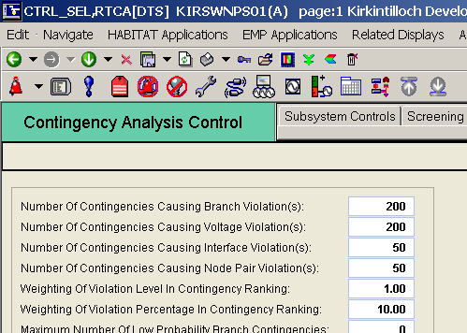
RTCA : Selection parameters
NERLDC
Selection uses the contingency severity rank:
User specifies the max number of potentially harmful contingencies to be retained for full analysis
Separately by constraint violation type : N1 N2 N3 N4

Slide 84
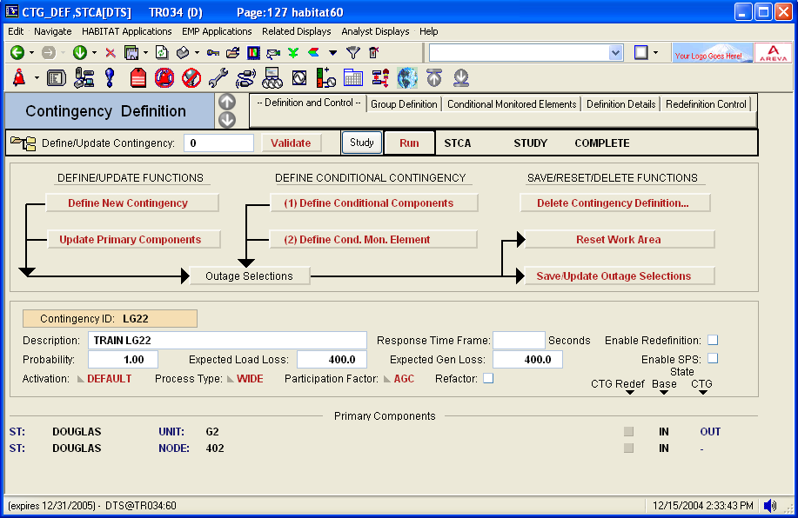
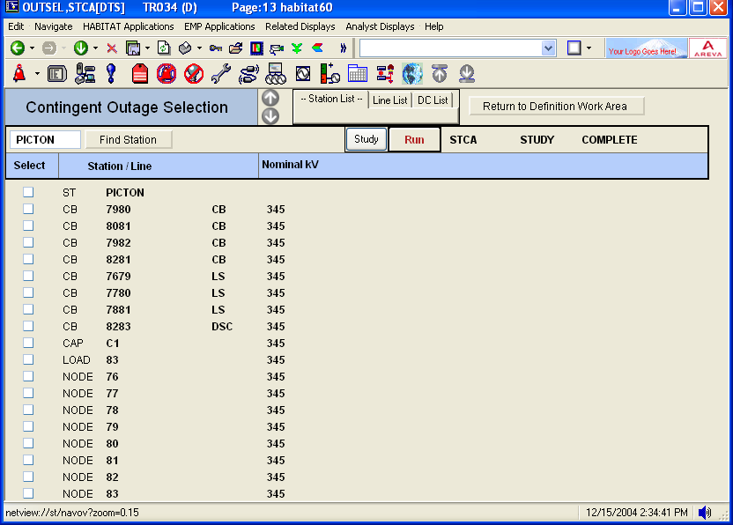
CA : Defining Contingencies
NERLDC
Enter contingency ID
Press Define New Contingency button
Make outage selections
Save your selections
If desired, include
conditional monitored element definition
Enter contingency details
Validate your entries
Save contingency definition

Slide 85

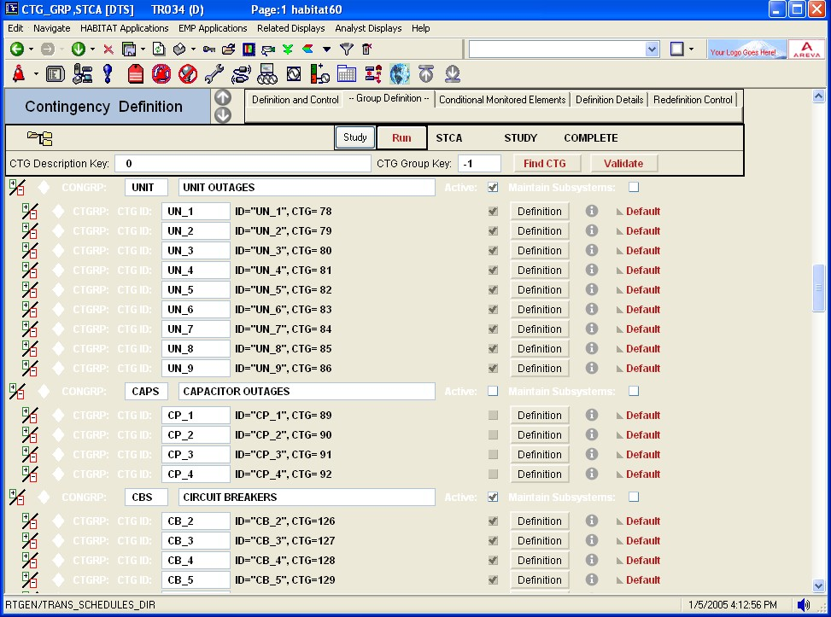
CA : Assigning contingencies to contingency groups
NERLDC
INSERT contingency group records
INSERT contingency records
Individual contingencies assigned to group
Individual contingencies can belong to more than one group

Slide 86
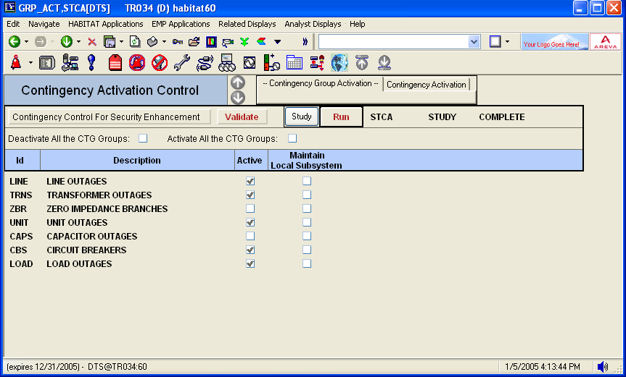

CA : Activating contingencies by group
NERLDC
Click
to activate CTG group

Slide 87
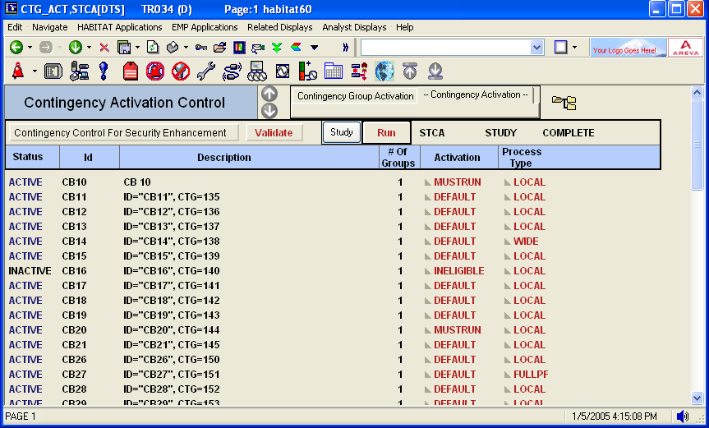
CA : Modifying contingency activation status
NERLDC
SET to INELIGIBLE to
prevent activation
SET to MUSTRUN to
force activation

Slide 88
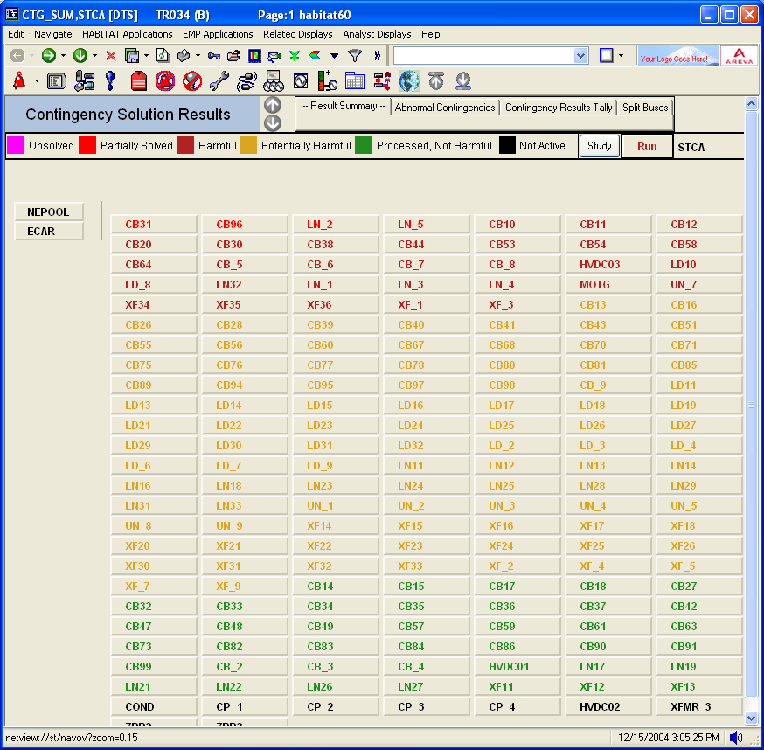
CA : Results Summary
NERLDC

Slide 89

Load Forecasting
NERLDC

Slide 90
LF : System Load Forecasting
Purpose
Provide system load forecast for each of the top level load areas in the load model hierarchy and their total
Short-term (horizon : 7 days ; time step : 1 or 1/2 hour)
Load forecast can be fed automatically to :
The short-term operations planning tools : e- terracommit
The bus loads forecasting function in the power flow application

Slide 91
LF : System Load Forecasting
NERLDC
Features
Develops weather profiles to enable interpolation between entered weather forecasts
Uses forecasted values of weather variables entered manually or
retrieved from files
Can produce a forecast for several “forecast areas”
External area loads can be specified as a function of the internal forecast areas
LF can produce a forecast for areas without weather variable
Provides extensive data change capabilities :
2 weeks in the past
schedule of corrections to be applied in the future
automatic re-scaling between 2 user specified points
Tracks forecasting error characteristics

Slide 92
LF : Related applications
NERLDC
❑ Provides 2 different applications
LFMODEL application
Model definition
Off-line study
LF application
On-line forecasting

Slide 93
LF Model Preparation
NERLDC
Define/modify the model
Validate the model
retrieve additional historical data
Retrieve historical data
savecases
Correct data errors
Remove abnormal days
Historical data files
Perform a study load forecast
Evaluate the results

Slide 94
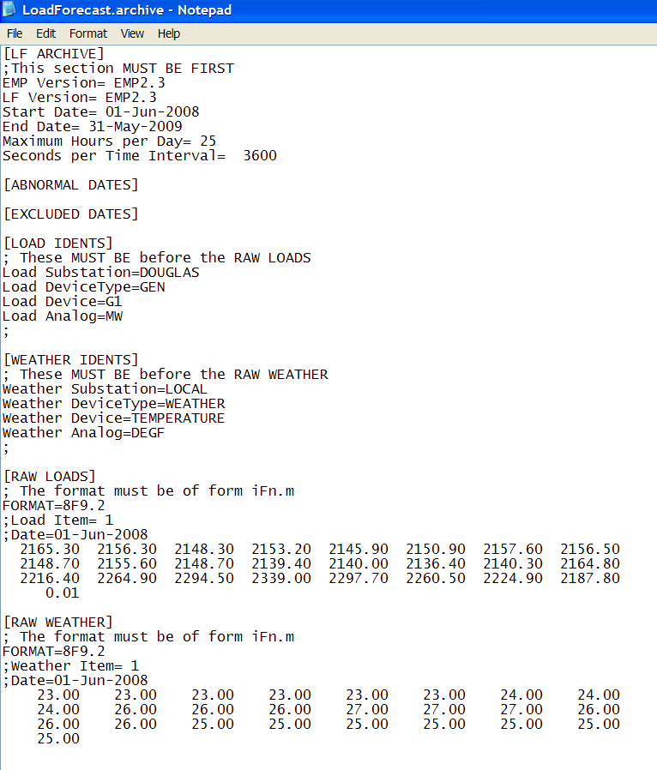
Retrieve Historical Information
NERLDC
❑ Populating Historical Data
Historical load and weather profiles are received in MS Excel Format.
Data are exported to a text (.archive) file.

Slide 95
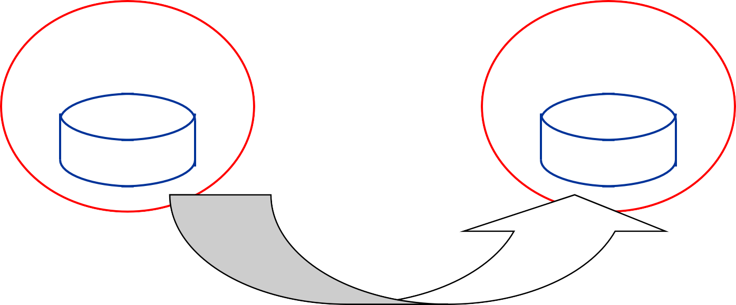
On-lining the model
NERLDC
❑ LF database on-lining copies from LFMODEL to LF:
The model structure
All model parameters
All historical data
LFMODEL
LF
database
database

Slide 96
Online Load Forecast Techniques
NERLDC
❑ Online Load Forecasting can be performed following 2 methods
Regression model :
Using the short-term load forecast model
Based on weather forecast
Non-Regression model :
Using similar days facilities.
Using load shapes facilities.

Slide 97
LF : Similar Day Forecast
NERLDC
❑ ALTERNATE FORECAST based on SIMILAR-DAY
User can select to use similar-day forecast instead of automatic forecast
Similar-day forecast is built from historical loads as follows :
for a particular load area and for a particular date, enter the search parameters :
weather variables (up to 3) to compare with the weather forecast
positive weight for each weather variable
days-of-the-week to search
months-of-the-year to search
command execution of the search : days found are presented in decreasing order of the fit quality
user selects the desired similar-day
There is no adjustment of the similar-day forecast to account for weather
differences

Slide 98
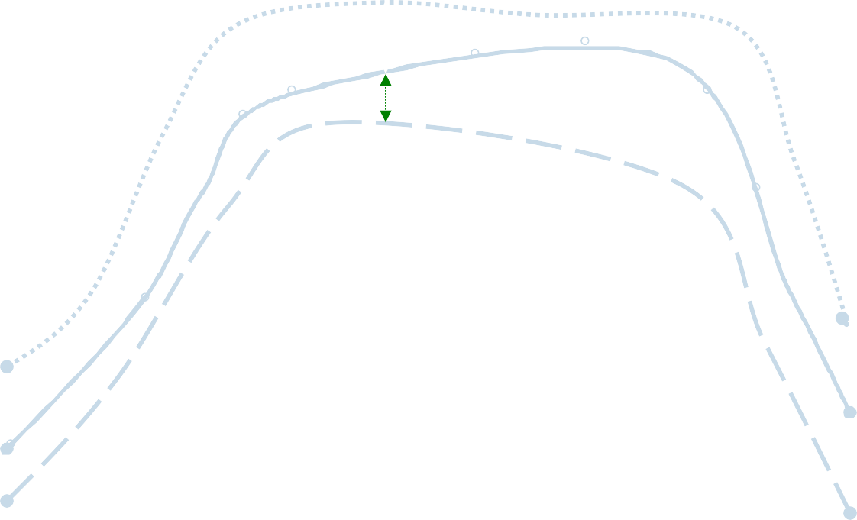
Similar Day Forecasting
NERLDC
Weather forecast for a future day Weather for day x in the past Weather for day y in the past
Temperature
a
b
Best fit
1
Time in Hours
24

Slide 99
LF : Load Shapes Library
NERLDC
❑ ALTERNATE FORECAST based on SHAPES
User can select to use alternate forecast instead of automatic forecast
Alternate forecast is built from a library of load shapes
Load shape library is created as follows :
user selects the historical load curve
for a particular load area
for a particular date
user assigns an ID and a name to that load shape (up to 32 curves)
Alternate load forecast is built as follows :
for a particular load area and for a particular date
user selects the desired load shape from the library
user enters desired MIN and MAX loads [ MW ]
selected load shape is re-scaled between 2 specified points

Slide 100
Load Shape forecasting
NERLDC
Shapes Library
Load History
Scaling
Day in forecast period

Slide 101

OPF, SENH, VVD
NERLDC

Slide 102
OPF (optimal power flow)
NERLDC
❑ OPF scope: any problem that involves the determination of the optimal steady-state operation of an Electric Power Generation-Transmission system
❑ Optimal Power Flow (OPF) = Power Flow +
+ Objective
+ Controls
+ Constraints
❑ Objective : value to be minimized, such as cost or MW losses
❑ Controls : unit MW, unit MVAR, capacitors and reactors, ULTC and phase
shifter taps, and area interchanges
❑ Constraints : high and low voltage limits, branch flows, interface flow limits, and node pair limits

Slide 103


Security Enhancement(SENH)
NERLDC
Can network security be improved?
MW
^{G} MVAr
kV
MW MVAr
TAP MW MVAr
Can operating costs be reduced?
MW MVAr
Load
❑ Security Enhancement looks for control changes in order to improve
the security and the economics of the power system:
For the basecase network state (current or postulated)
❑ A feasible state is a network solution in which all components
operate within their limits
❑ An optimal state is a feasible state for which the operating cost has been reduced to a minimum
G

Slide 104
Voltage – Var Dispatch (VVD)
NERLDC
❑ Purpose
Provide real-time recommendations regarding voltage related controls :
voltage regulator set-points
tap positions for non-regulating transformer
connection status for non-regulating shunt reactance
In order to eliminate voltage violations and minimize transmission losses (if a feasible solution can be found)
❑ Features
OPF algorithm with fixed MW controls, applied to SE results
Flexible definition of controls
Flexible definition of constraints to be enforced
MVAr gen. limits given the current MW output
SVC (static VAr compensators)
either as a fixed shunt reactance
or as regulating a fixed voltage set-point

Slide 105
QUESTIONS?
NERLDC
LIMITATIONS!

Slide 106

You
Thank

